Slide 1
END-TO-END DATA ANALYTICS PROJECT
Multi-Branch Retail Performance
& Operations Intelligence
Excel • MySQL • SQL • Power BI • DAX
Mumbai | Pune | Delhi | Bangalore
Abhirami Ananthakumar
Data Analyst

Slide 2
OVERVIEW
Executive Summary
This initiative establishes a comprehensive operational intelligence framework for retail enterprises across four major urban centers, transforming raw retail data into an interactive BI solution covering sales, store performance, products, customers, shipments, returns and refunds.
$3.83B
29.77%
Gross Sales
YoY Growth
₹12.76K
50K
Initial profiling in Excel, structured analysis and validation in MySQL/SQL.
Power BI + DAX for data modeling, KPI development and interactive reporting.
Five management-ready dashboards, each independently validated against SQL.
Findings translated into prioritized business recommendations.
AOV
Customers
98.56%
5
Repeat Rate
Dashboards
Multi-Branch Retail Performance & Operations Intelligence
2

Slide 3
BUSINESS CONTEXT
Business Problem & Objectives
BUSINESS PROBLEM
KEY OBJECTIVES
Identify strongest and weakest cities/stores.
Measure sales, orders, AOV and growth.
Identify high-performing products and categories.
Understand customer frequency, value and repeat behavior.
Monitor shipment status and late delivery.
Measure returns and refund value.
Compare Mumbai, Pune, Delhi & Bangalore performance.
Identify top products/categories and sales contribution.
Analyze customer value, frequency and repeat behavior.
Evaluate shipment performance and late-delivery patterns.
Analyze returns/refunds for operational impact areas.
Deliver validated, management-ready dashboards.
Multi-Branch Retail Performance & Operations Intelligence
3

Slide 4
DATA FOUNDATION
Dataset Overview
A 12-table retail data warehouse containing approximately 1.59 million records.
Table | Records
Categories | 30
Customers | 50,000
Employee | 1,000
Order Items | 600,000
Orders | 300,000
Payments | 300,000
Products | 10,000
Promotions | 50
Returns | 30,000
Shipments | 300,000
Stores | 100
Suppliers | 200
TOTAL RECORDS
1,591,380
CORE ANALYTICAL FLOW
Customers → Orders → Order Items → Returns
Orders → Shipments
Relationship and filter propagation were tested during development, particularly for city-level shipment and return analysis.
Multi-Branch Retail Performance & Operations Intelligence
4

Slide 5
METHODOLOGY
Technology Stack & Analytics Workflow
Excel
Initial data exploration
ANALYTICS WORKFLOW
MySQL 8.0
Data warehouse querying, EDA, aggregation & validation
1
Raw Retail Data
SQL
EDA, joins, aggregations, distinct counts, KPI validation
2
Initial Data Inspection
3
MySQL/SQL Analysis
Power BI
Data modeling, relationships, slicers & dashboards
4
SQL KPI Validation
DAX
Reusable measures, ratios & calculated columns
5
Power BI Data Model
6
DAX Measures
Google Docs / Slides
Documentation & presentation
Dashboards
7
GitHub
Portfolio hosting & version control
8
SQL Reconciliation
9
Business Insights
10
Recommendations
Multi-Branch Retail Performance & Operations Intelligence
5

Slide 6
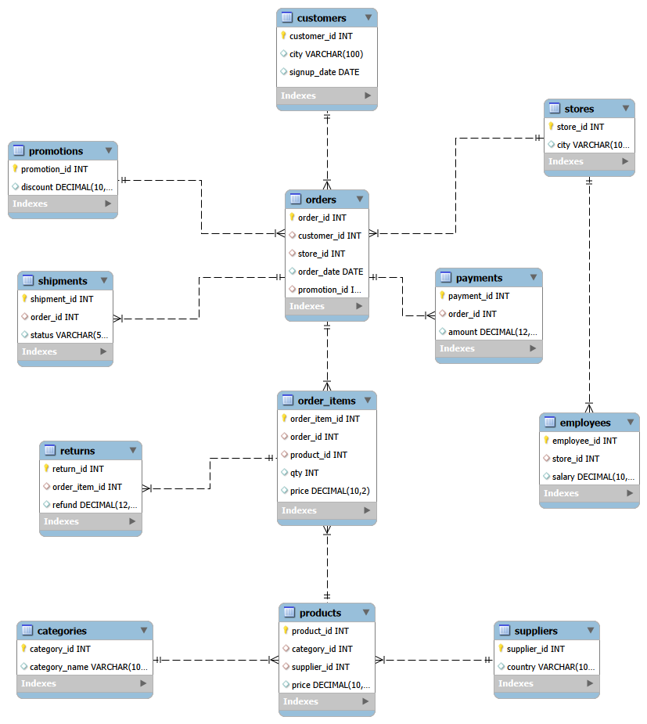
DATA ARCHITECTURE
Data Model
CORE ANALYTICAL FLOW
Customers → Orders → Order Items → Returns
Orders → Shipments
12 interconnected tables spanning customers, stores, employees, orders, order items, payments, shipments, returns, products, categories, suppliers and promotions.
Relationship and filter propagation were tested during development, particularly for city-level shipment and return analysis.
Multi-Branch Retail Performance & Operations Intelligence
6

Slide 7
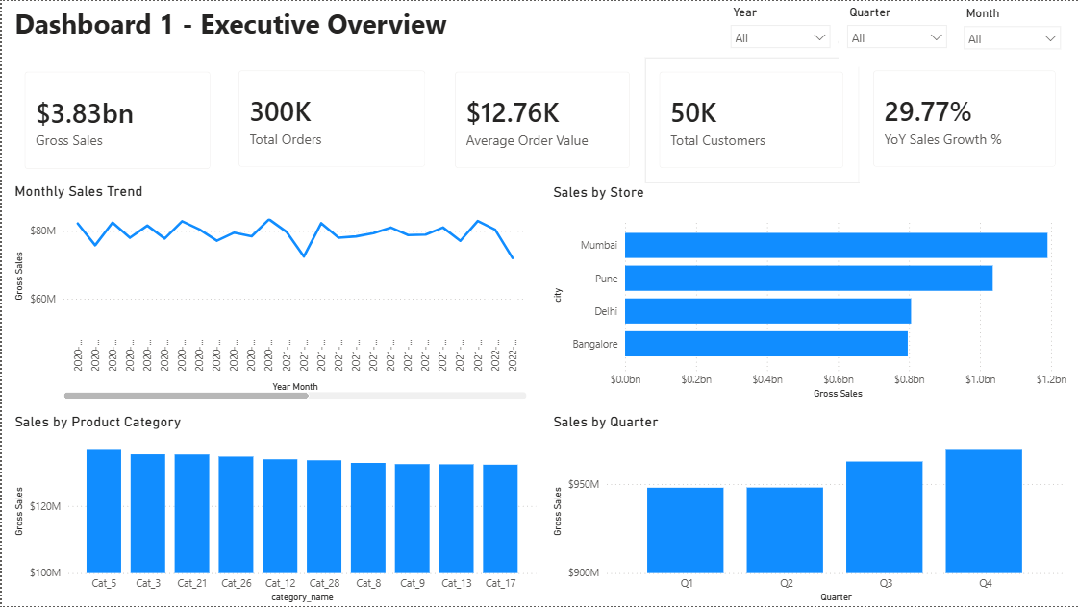
DASHBOARD 1 OF 5
Executive Overview
KEY FINDINGS
Gross sales are approximately ₹3.83B.
YoY sales growth is 29.77%.
AOV is approximately ₹12.76K.
Mumbai is the strongest revenue market.
Q4 is the strongest quarter.
MANAGEMENT CONCLUSION
The retail business generated approximately $3.83B in gross sales across four cities, with Mumbai contributing the highest sales. Sales grew 29.77% YoY, while AOV reached ₹12.76K. Revenue remained relatively stable across months, with Q4 emerging as the strongest quarter.
Multi-Branch Retail Performance & Operations Intelligence
7

Slide 8
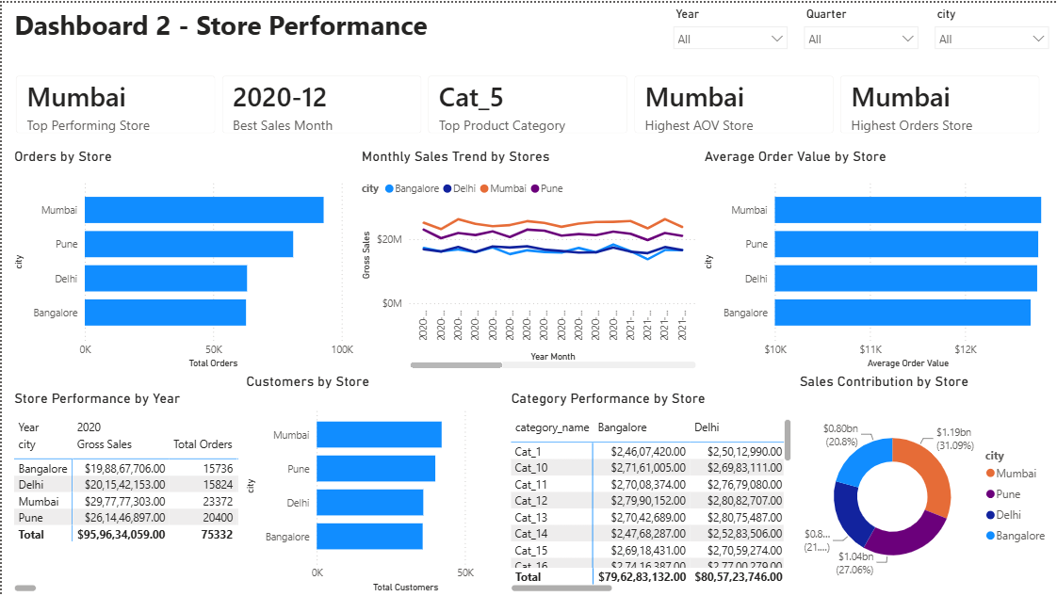
DASHBOARD 2 OF 5
Store Performance
KEY FINDINGS
Mumbai is the strongest-performing market.
Mumbai leads order volume and customer base.
Mumbai has the strongest AOV position.
Mumbai contributes approximately 31% of overall sales.
Category performance varies by city.
MANAGEMENT CONCLUSION
Mumbai leads in orders, customers, average order value and overall sales contribution. Pune follows, while Delhi and Bangalore show comparatively lower performance. Category-level performance also varies between cities, highlighting the need for location-specific strategies.
Multi-Branch Retail Performance & Operations Intelligence
8

Slide 9
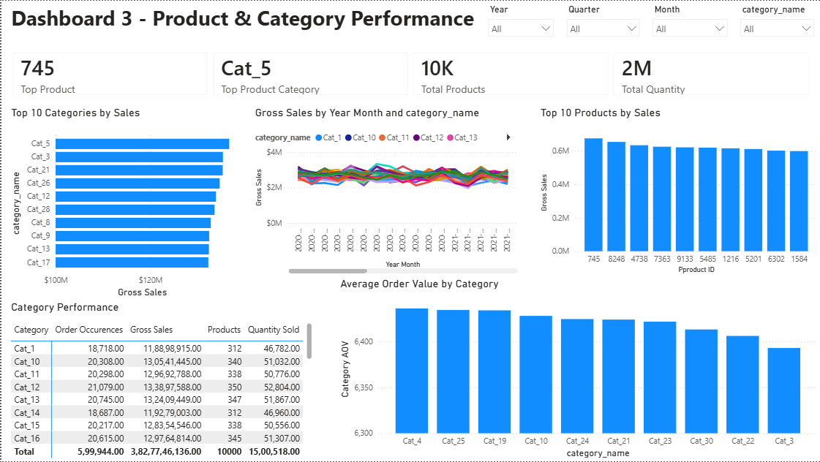
DASHBOARD 3 OF 5
Product & Category Performance
KEY FINDINGS
Product 745 is the top product.
Cat_5 is the top category.
Approximately 10K distinct products are represented.
Approximately 2M units are represented.
Category AOV varies, creating cross-selling opportunities.
MANAGEMENT CONCLUSION
Product and category performance is relatively diversified, with Cat_5 leading and Product 745 as the top seller. Differences in category AOV indicate opportunities to optimize product mix, pricing and cross-selling.
Multi-Branch Retail Performance & Operations Intelligence
9

Slide 10
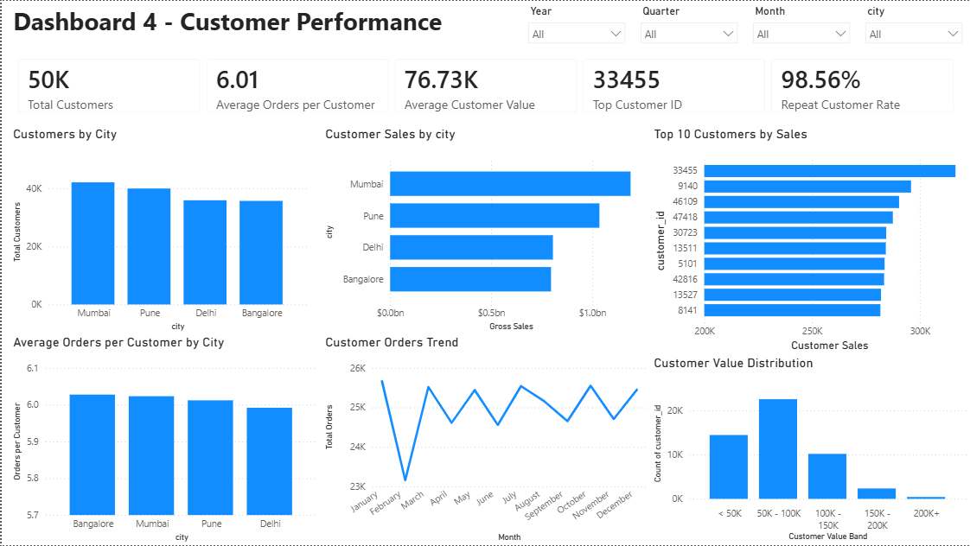
DASHBOARD 4 OF 5
Customer Performance
KEY FINDINGS
Mumbai has the largest customer base and highest customer sales.
Average orders per customer are around 6.
Repeat Customer Rate is 98.56%.
Largest customer-value segment is 50K–100K.
High-value customers are a smaller segment.
MANAGEMENT CONCLUSION
Mumbai leads in customer base and sales value, with an exceptionally strong 98.56% repeat customer rate. The largest growth lever is increasing the value of existing customers rather than pure acquisition.
Multi-Branch Retail Performance & Operations Intelligence
10

Slide 11
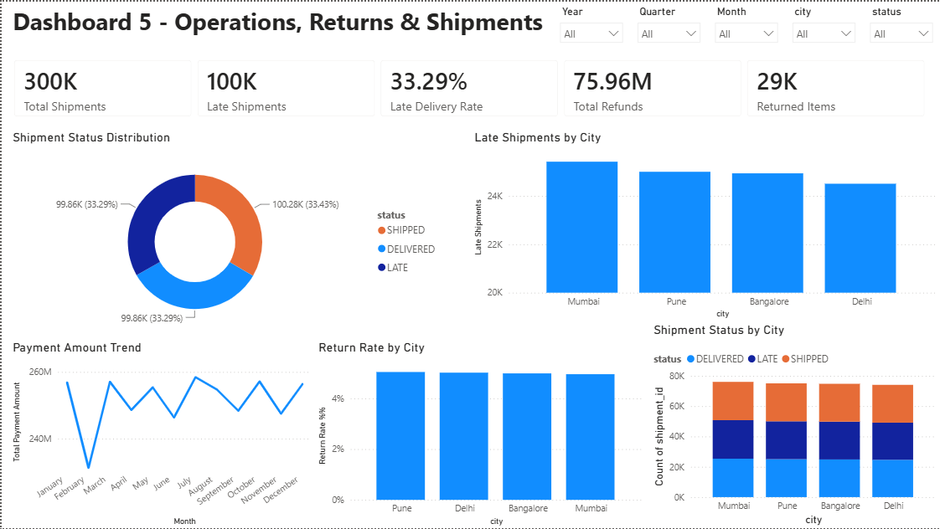
DASHBOARD 5 OF 5
Operations, Returns & Shipments
KEY FINDINGS
99,855 of 300,000 shipments are late — a 33.29% late-delivery rate.
Mumbai has the highest absolute late-shipment count.
Pune has the highest return rate at 5.04%.
Refunds total ₹75.96M.
29,251 order items were returned.
MANAGEMENT CONCLUSION
Operations analysis reveals a significant delivery challenge at a 33.29% late-delivery rate. Mumbai records the highest absolute late shipments while Pune has the highest return rate. Delivery reliability and return reduction are key operational priorities.
Multi-Branch Retail Performance & Operations Intelligence
11

Slide 12
VALIDATION
Consolidated Validated KPI Register
All major Power BI KPIs and analytical outputs were reconciled against SQL before finalization.
Dashboard | Metric | Value
D1 Executive | Gross Sales | ~₹3.83B
D1 Executive | YoY Growth | 29.77%
D2 Store | Top Market | Mumbai (~31%)
D3 Product | Top Product / Category | 745 / Cat_5
D4 Customer | Repeat Rate | 98.56%
D4 Customer | Avg Customer Value | ₹76.73K
D5 Operations | Late Delivery Rate | 33.29%
D5 Operations | Refunds | ₹75.96M
Multi-Branch Retail Performance & Operations Intelligence
12

Slide 13
ACTION PLAN
Business Recommendations
1
Improve Delivery Reliability
High
2
Increase Customer Value
High
Reduce the 33.29% late-delivery rate via monthly targets and bottleneck analysis.
Leverage 98.56% repeat rate with loyalty, cross-sell and upsell programs.
3
Reduce Avoidable Returns
Medium
4
Strengthen Market Performance
Medium
Investigate high-return products, categories and cities to cut refund cost.
Sustain Mumbai's lead; replicate its strategies in Pune, Delhi, Bangalore.
5
Optimize Product Portfolio
Medium
6
Leverage Q4 Performance
Low
Identify high/low performers among ~10K products for SKU rationalization.
Apply Q4 demand patterns to inventory & promotions in weaker quarters.
Multi-Branch Retail Performance & Operations Intelligence
13

Slide 14
ANALYTICAL INTEGRITY
Data Limitations & Caveats
SOURCE-DATA LIMITATIONS
No explicit product cost/COGS — profit cannot be derived.
Signup-date inconsistency affects tenure/cohort analysis.
No return-date field — only order-month association.
Multiple return records can reference one order item.
No payment method/status fields available.
Shipment status limited to SHIPPED, DELIVERED, LATE.
PREFERRED TERMINOLOGY
Use | Avoid
Gross sales / revenue | Profit / margin
Promotion-associated sales | Sales caused by promotion
Distinct returned order items | Return records = unique items
Payment difference | Payment error
Higher return rate among late orders | Late shipment caused the return
Multi-Branch Retail Performance & Operations Intelligence
14

Slide 15
Thank You
Multi-Branch Retail Performance & Operations Intelligence
Abhirami Ananthakumar
Data Analyst
GitHub: github.com/abhirami-ananthakumar/multi-branch-retail-performance-operations-analytics
LinkedIn: linkedin.com/in/abhirami-ananthakumar-8b83a5256

